Slide 1
COM 212: Data Structures
Stephen Douglass

Slide 2
Abstract Data Type (ADT)
ADT is an abstraction of a data structure
Implementation independent
A mathematical model for a certain data structures that has similar behavior
ADT specifies
Data stored
Operations on the data (methods)
Error conditions associated with operations

Slide 3
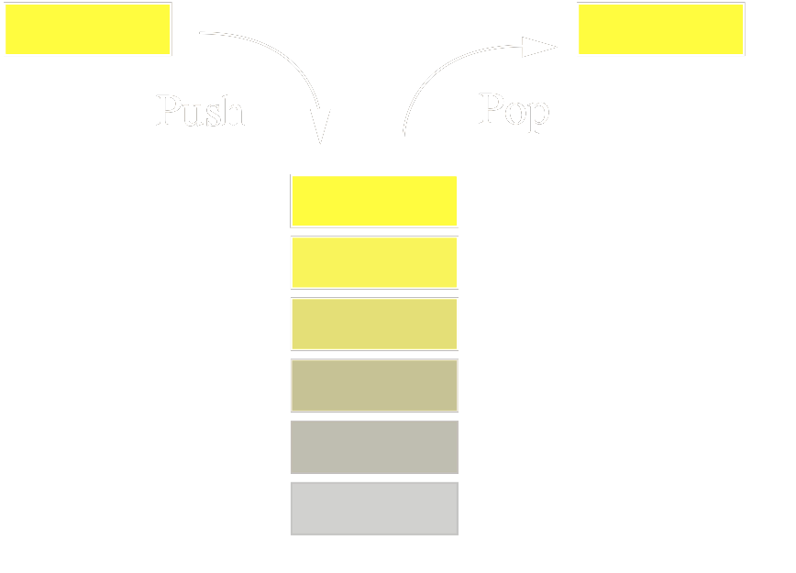
Stack
Last-In-First-Out (LIFO): the last element added to the structure must be the first one to be removed (undo edit sequence in text editor, visited page history in web browser)
push & pop (operation occurs at one end)

Slide 4
Stack Operations & Error conditons
void push(Object)
Object pop()
Object top()
int size()
boolean isEmpty()
Error: pop or top on empty stack

Slide 5
Stack: Application
Syntax Parsing (Parenthesis/Tag Matching)
correct: ( )(( )){([( )])}
correct?: ((( )(( )){([( )])}
incorrect: )(( )){([( )])}
incorrect: ({[ ])}
incorrect: (
For each parenthesis
if it is opening one
push
else
pop and compare

Slide 6
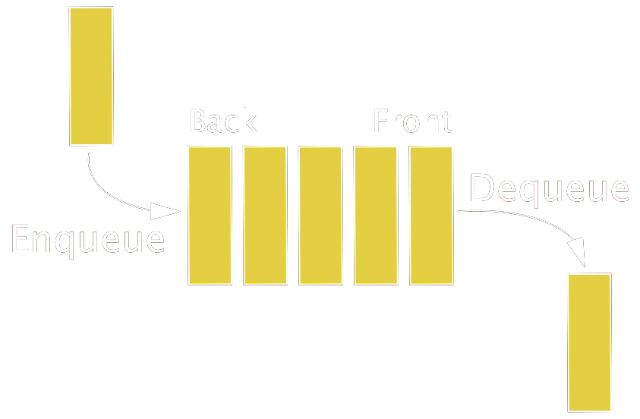
Queue
First-In-First-Out (FIFO): the first element added to the structure must be the first one to be removed (i.e. waiting list, printing jobs)
enqueue & dequeue (ops on both sides)

Slide 7
Queue Operations & Error conditions
void enqueue(Object)
Object dequeue()
Object front()
int size()
boolean isEmpty()
Error: dequeue or front on empty Q

Slide 8
Queue: Application
Round-Robin Scheduler
Fair resource sharing among requested tasks
Assign resource from the first one to the last one in the queue (one-by-one for fixed amount of time) and go around if needed
Queue
dequeue
enqueue
Shared Service

